Slide 1

HPI CPS Lab MegaModel
System Analysis and Modeling Group
Notes:
We contribute:
Applied, adapted and evaluated an existing development methodology for the robotic system application domain
evaluated and adapted the combination soft and hard real-time at the application/component level using a MDE approach
An Methodology for robotic system should support:
Different development activities
Modeling, simulation, verification/ testing
Different Stages
Simulation, Prototyping, (Pre-)production
Supported tools
Supported libraries
Integrated toolchain
Reflect hard and soft real-time constraints
we just read the call for paper and many of these issues adressed there are already solved in other domains
We ask, why do not use these concepts in robotics to and than we try
We reflect HRT and SRT and the interaction between at modeling level
Adapt an existing methodology from the automotive domain to the robotic domain
Microwave example

Slide 2
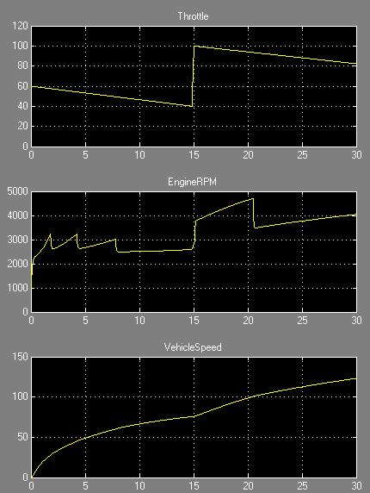
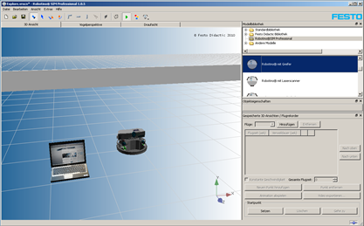
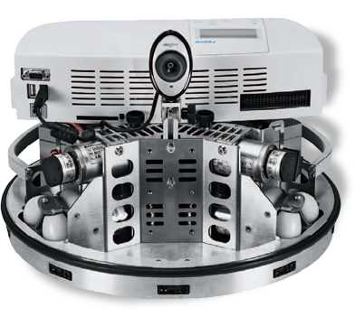
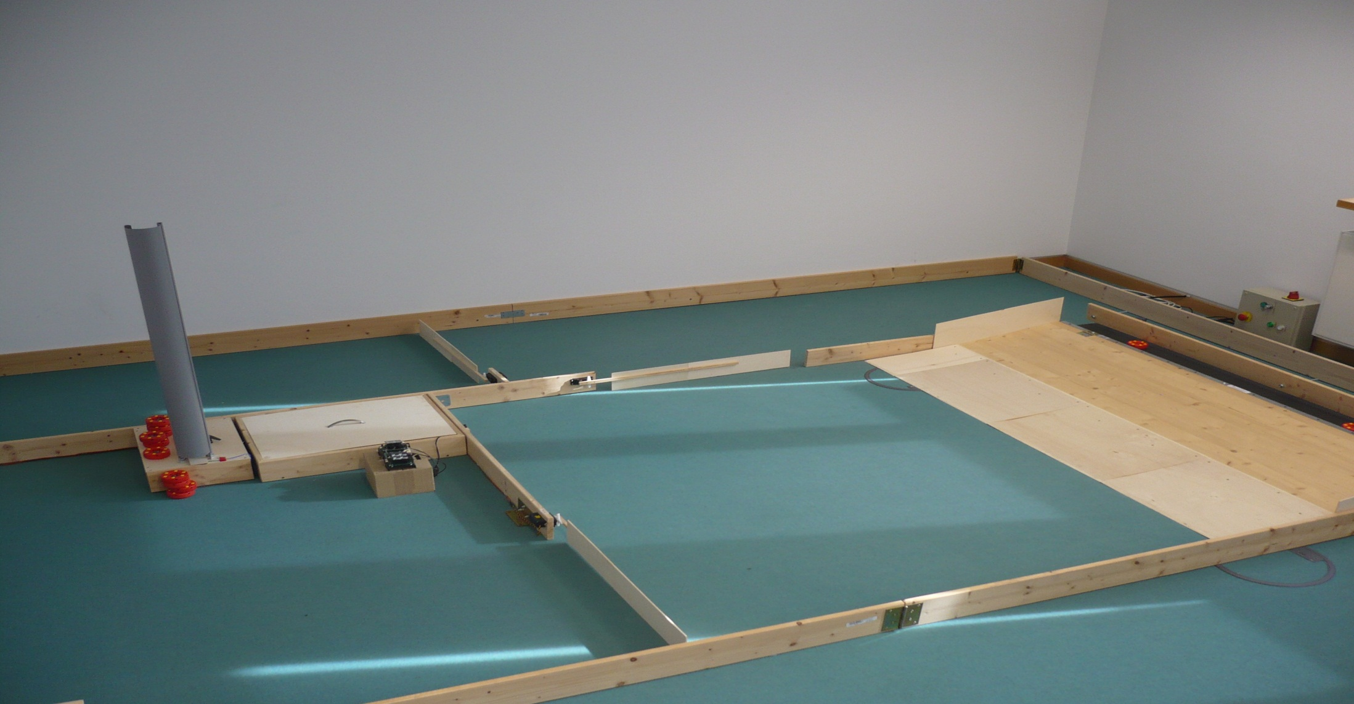
MM
MT
input
Legend:
plant
control
Output
MT/MiL
tool
MiL
model
input
control
Output
Output
plant
RP
control
Output
Simulation
stage
plant
RoboSim
control
Output
RP
RoboSim
SiL
SiL
control
plant
RoboSim
control
SiL
Prototyping
stage
HiL
HiL
control
limking
Pre-production
stage
ST

Slide 3
MM
MT
Legend:
input
model
operation
plant
control
Output
model(s)
MiL
input
control
Output
Output
plant
RP
control
Output
plant
RoboSim
control
Output
RoboSim
SiL
control
plant
RoboSim
control
HiL
HiL
control
limking

